Slide 1


Evaluating Fairness of Machine Learning Models Under Uncertain and Incomplete Information
Sara Rostami 810100355

Slide 2

02
Motivation
01
Proposed Method
Results
04
Conclusion
03

Slide 3

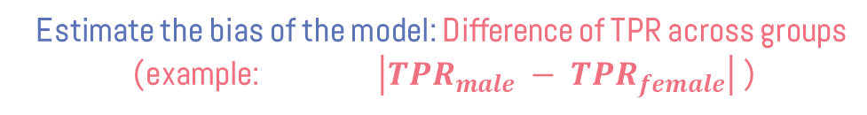
Motivation
An ML model for deciding bank loan applications
Credit score
Income
Debt
…
Gets loan?
Yes
No
Estimate the bias of the model: Difference of TPR across groups
(example: $\left|{TPR}_{male} − {TPR}_{female}\right|$ )
Equal Opportunity metric (Independence)
01

Slide 4
Motivation (Cont.)
Weakness of the Equal Opportunity metric
Credit score
Income
Debt
Sex
…
Gets loan?
Yes
No
We need a dataset containing both the label and the sensitive attribute
02

Slide 5

Motivation (Cont.)
Setting: Dataset containing both class label and sensitive attribute is scarce
Goal: Bias estimation in Demographic scarce setting
03

Slide 6

Motivation (Cont.)
Popular approach:
Use a prediction model h for the sensitive attribute
Advantages:
Decouples Data Requirement
Challenges:
What is considered a good prediction model h ?
How should h be used ?
h
Income | Debt | Sex | Y
120k | 5k | F | Yes
250k | 150k | M | No
... | … | … | …
04

Slide 7

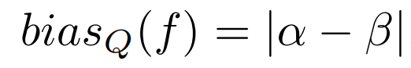
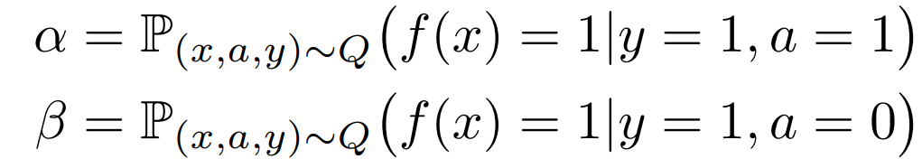

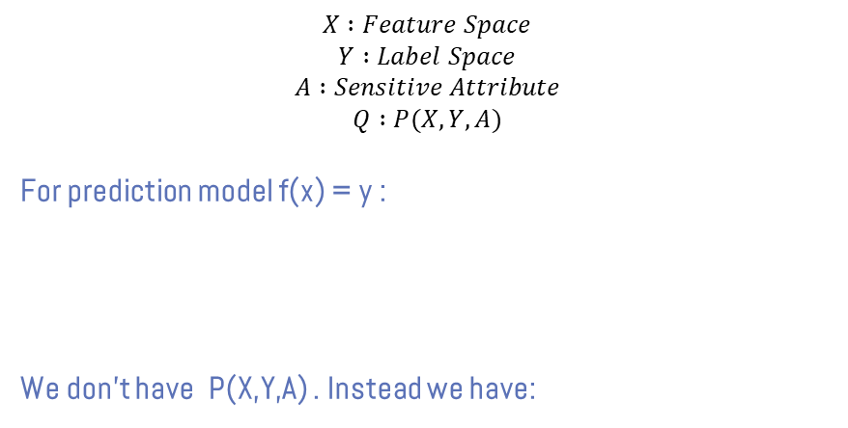
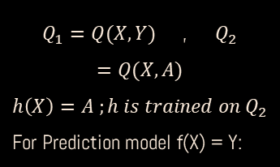
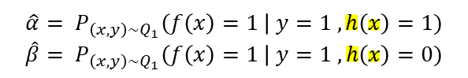
Proposed Method
$$X :Feature Space$$
$$Y :Label Space$$
$$A :Sensitive Attribute$$
$$Q :P(X, Y, A)$$
For prediction model f(x) = y :
We don’t have P(X,Y,A) . Instead we have:
$Q_{1}=Q(X,Y)$ , $Q_{2}=Q(X,A)$
$$h\left(X\right)=A ;h is trained on Q_{2}$$
For Prediction model f(X) = Y:
$$\hat{α}= P_{\left(x,y\right)\sim Q_{1}}\left(f\left(x\right)=1 \right| y=1 , h\left(x\right)=1)$$
$$\hat{β}= P_{\left(x,y\right)\sim Q_{1}}\left(f\left(x\right)=1 \right| y=1 , h\left(x\right)=0)$$
05

Slide 8
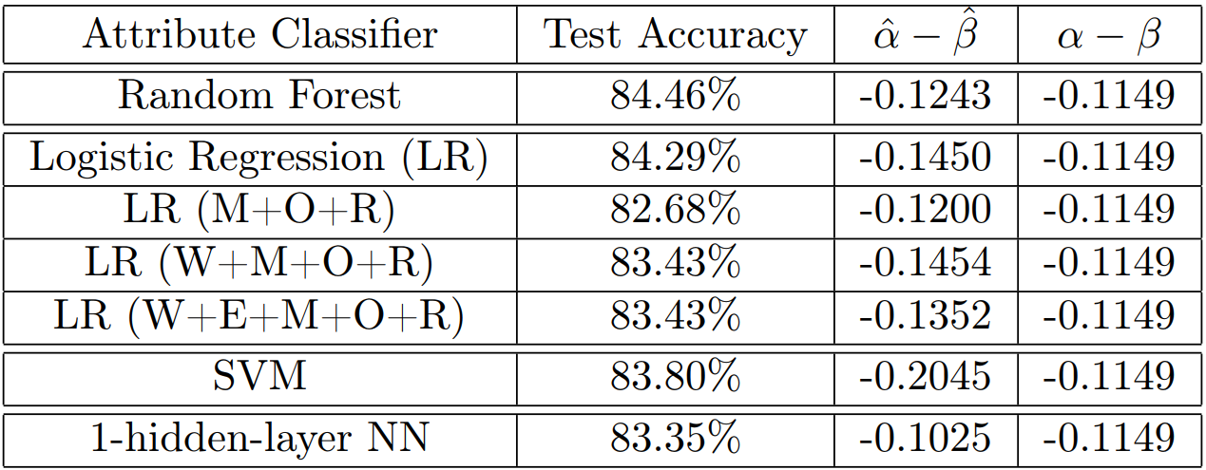
Results Q1
Answering Q1: What is considered a good sensitive attribute classifier h?
(h)
Actual Bias: 0.1149
Test Accuracy is not correlated with effectiveness for bias estimation
06

Slide 9

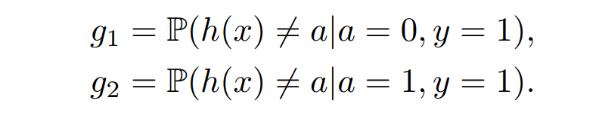
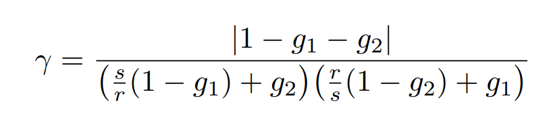
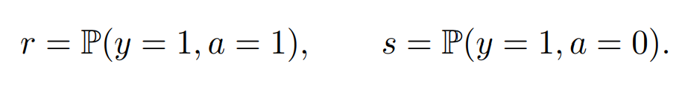
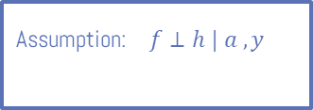
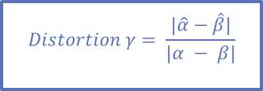
Proposed Method (Cont.)
$$Distortion γ= \frac{|\hat{α}−\hat{β}|}{|α − β|}$$
Assumption: $f⊥h | a , y$
If the assumption holds:
Range: ( 0 , 1 )
07

Slide 10

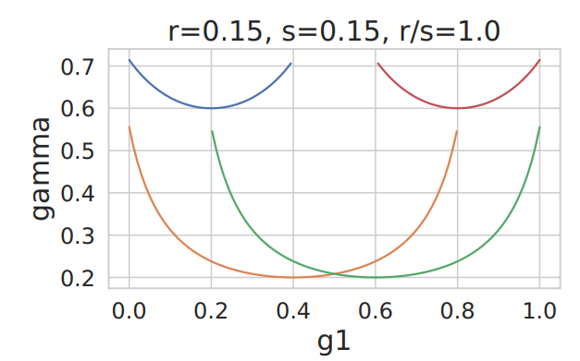
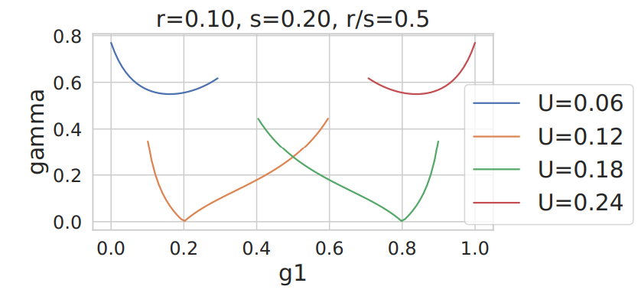
Results Q1
Theorem: If the assumption holds and r=s then, for a given budget U, the distortion is maximized at one of the extreme points, i.e., g1 = 0, g2 = 0, g1= 1, g2 =1
Maximize Distortion factor (Gamma)
This theorem holds true for other values of r and s
08

Slide 11

Proposed Method (Cont.)
Answering Q2: How should we use a given sensitive attribute classifier h to better estimate the bias?
We consider a setting where some amount of common data (y,a) is available, then propose an efficient Algorithm, called Active Sampling Algorithm:
Carefully decides when to trust h
Uses predictions of h to create an uncertainty estimate
Decides whether it wants to query for both the label and the sensitive attribute information for the data point or not
Significantly lower common data requirement
09

Slide 12

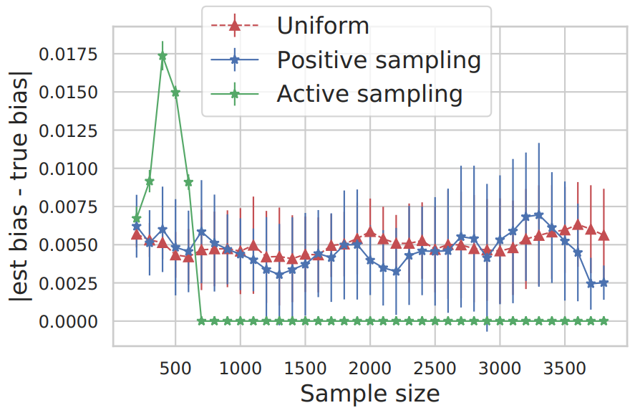
Results Q2
10

Slide 13
Conclusion
Goal: Understanding Bias Estimation in demographic scarce setting
Findings:
Sensitive attribute classifier must be designed carefully
Use a given attribute classifier prudently
Future Directions:
Characterize optimal sensitive attribute classifier under general conditions
New algorithmic techniques/regulaizers to select good proxies ?
11

Slide 14
THANKS FOR GIVING ME YOUR ATTENTION!

Slide 15

REFERENCE
Awasthi, P., Beutel, A., Kleindessner, M., Morgenstern, J., & Wang, X. (2021, March). Evaluating fairness of machine learning models under uncertain and incomplete information. In Proceedings of the 2021 ACM Conference on Fairness, Accountability, and Transparency (pp. 206-214).

Slide 16
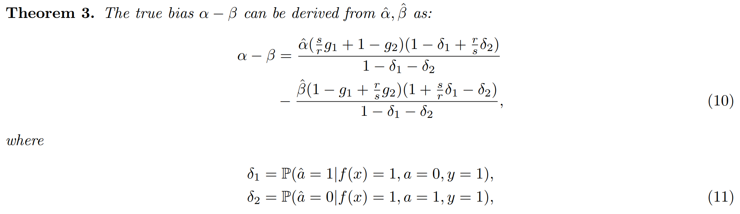
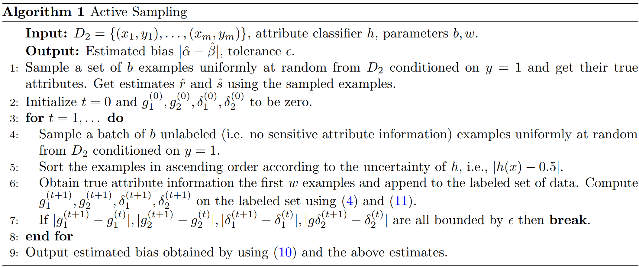
Appendix A: Active Sampling Algorithm

